Slide 1






Project Title:Job finding Website
Md. Rayhan Ahmed Shis
2125051067
Batch- 50
Section- 7C1
Mohammad Shakibul Hasan
2215151115
Batch- 51
Section- 7C1
Submitted To:
Nazmun Nahar Tui
Lecturer,Dept. of CSE
Nusrat Jahan (2215151114)
Batch- 51
Section- 7C1
Most.Nasrin Akter (2215151142)
Batch- 51
Section- 7C2
1
Notes:
1

Slide 2
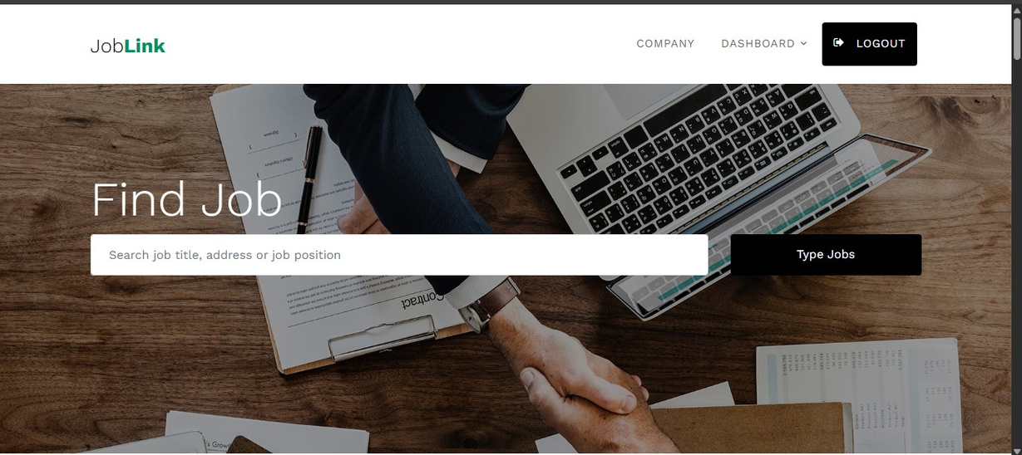
Website name:JobLink
Introduction:
The Job Portal is designed to bridge the gap between job seekers and employers, providing a seamless and efficient recruitment process. The platform will offer user-friendly interfaces, secure authentication, and effective job filtering mechanisms. By utilizing the Laravel stack, the system ensures scalability, security, and maintainability. The project aligns with modern web application standards, focusing on ease of use and robust performance.
2

Slide 3

Project Objective: Streamlining the Hiring Process
User authentication (Job Seekers and Employers)
Profile and resume management
Job search and filtering
Admin panel for moderation
3
Notes:
2

Slide 4
Technology Stack: Powering a Seamless Experience
Backend: Laravel PHP
Frontend: Vue.js
Database & Other Tech
Version 10.x with MVC architecture
Version 3.x component-based design
MySQL 8.x optimized schema
HTML5, CSS3, JavaScript ES6+, AJAX
RESTful APIs for scalability
Vuex for robust state management
4
Notes:
3

Slide 5

Key Features: JobLink’s Core Functionality
Job Seeker Profiles
Job Postings
Detailed skills, resume parsing, LinkedIn integration
Advanced filters, mobile-responsive design
Application Tracking
Employer Dashboard
Real-time status updates for candidates
Analytics and automated notifications
5
Notes:
4

Slide 6
Newly Added Features: Enhancing the Platform
Job save
send job
Resume Upload:
user can bookmark there job
user can send a job
Job seekers can upload and manage their resumes, making it easy for employers to review qualifications.
6
Notes:
5

Slide 7

Conclusion:
Job portals have revolutionized the hiring process, providing a convenient and efficient platform for job seekers and employers. By embracing technology and focusing on user experience, job portals continue to play a vital role in connecting talent with opportunities.
7

Slide 8

Thank You
8
Notes:
8

